Slide 1
Estonia’s policies and practices in improving children well-being
Anniki Lai
Independent expert on Social Policy and Child Welfare

Slide 2
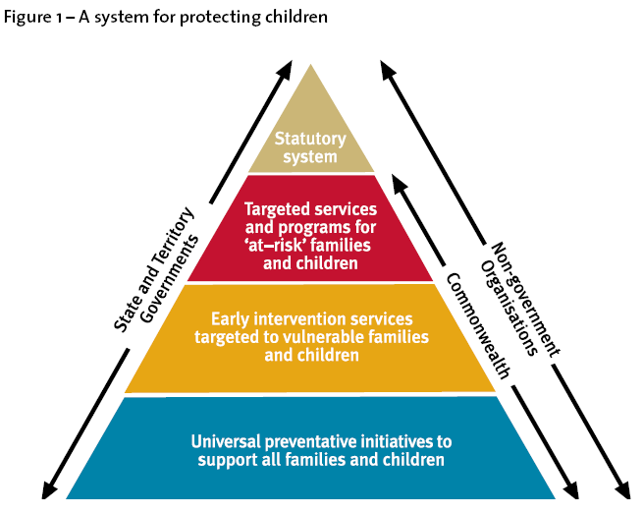
Main principles of the Strategy for Children and Families 2012-2020
Focus on the best interest of the child
Public health approach – levels of interventions to prevent problems
  Defining the magnitude and prevalence of the problem
  Identifying risk and protective factors
  Selecting interventions that work
Investments to Prevention and Early Intervention to avoid later costs
Use of evidence-based interventions (programs which have been proven effective)
Multi-sectorial cooperation and coordination

Slide 3
Strategy for Children and Families: 5 Policy Goals
1. Implementing knowledge-based and uniform child and family policy
2. Promoting positive parenting
3. Improving early intervention and strenghtening child protection system
5. Reconciliation of work, family and private life
4. Providing support to families to cope economically
Main Objective Improving the well-being of children and families

Slide 4

Changes with the new Child Protection Act
Introduction of the the new organization of the child protection system
Obligation for state and local municipalities to develop measures in order to prevent the child’s need for assistance and to decrease the existing problems
Explicit prohibition of corporal punishment of children
State responsibility to offer trainings and work counselling for the municipal child welfare workers
Every child protection case has to be assessed (BBIC model) and case plan developed (STAR data register)
Internal evaluation obligation for children institutions to evaluate efficiency of activities upon ensuring the child’s rights and well-being are evaluated
New Child Protection Act in force from January 1, 2016

Slide 5
Organization of child protection in Estonia
Child protection committee
Strategic and political leadership, coordinating and monitoring the implementation of strategies and policies, cross-sectorial coordination body
Ministry of Social Affairs
Coordination of the implementation of child protection policy, preparing relevant legislation and strategies, securing the implementation of the policies. Planning and developing the child protection measures and services. Coordination of inter-ministerial working group. Data collection and analysis.
State Agency
Social Insurance Board (Child Protection Unit)
State services and benefits. Case management and strategic support for LG-s, responsible for both inner-country and International adoption, monitoring of child protection, work counselling for child protection workers, implementing specialized services (EBP-s), coordination of child protection organization and implementation /prevention. Data collection.
County Governer (until 2018)
Monitoring the quality of the services
Local municipality
Direct assistance, case-management, services and financial support for children and families. Preparing local strategies to plan long-term actions basing on the data. Data collection.

Slide 6
Services to support children and families
State
State and Municipality
Level of specialization
Municipality
Specialist level services
Institutions
State
Probation
Co-operation with parents
Child participation
Integration of services
Mental health service
Adoption
Rehabilitation and reintegration
State support to municipalities
Needs assessment
State and Municipality
Primary prevention
Parenting and family support
Services for children with disablities
Prevention programmes
Foster families
Case management
Decisions on assistance and placement of a child
Municipality
Municipal services
Alternative care facilities
Economical support
In-home assistance and community services
Home visits
Notes:
Økonomisk ansvar stat-kommune

Slide 7
Getting evidence into policy and practice
  CHILDREN AND FAMILY WELL-BEING PROFILE
    To promote evidence-based policy making in local level
    Set of indicators, tools to collect and analyze the data
    Pilot in 2015-2016:
      Development of the profile, testing in 8 municipalities,
      Data collection and analysis support
      Consultations for municipalities on strategic planning
    Continuous strategic support by the State Child Protection Unit
  EVALUATION AND ASSESSMENT OF INTERVENTIONS
  Piloting evidence based programs (Incredible Years, Good Behavior Games, KiVA, Multidimentional Family Therapy, ART)

Slide 8
Relevant reforms and initiatives
Children in conflict with the law – juvenile committees closed down and providing support not punishment through the child protection system (social rehabilitation, mediation, incl closed institution)
Alternative care – law change: after 2018 local municipalities will be responsible for organizing alternative care services including state funding. Improving DI - moving towards family based care, professional foster families (ESF 2014-2020)
Children with disabilities – increasing the availability and accessibility of the support services, integrating services between education and social sector. (33 mill euros 2017-2020). More responsibility organising services given to local government with state funding.
Investments to child day care– in 2017 local municipalities and private sector are supported to build new and flexible child day care places (ESF 2014-2020)
Increased family benefits – additional benefits for families with more than 3 children (3-6 children 200 eur, 7 and more 370 eur per month)

Slide 9
Preparing next reforms
Reforming the system of parental leave and benefits: better flexibility (parental benefit can be used during 3 years instead of current 1,5 year) and supporting fathers involvement (1-month individual right added to the current parental benefit period)
State support for employers in employing 13-16 y/o children and youth to provide youth with work experience and prevent NEET youth (60% of all unemployed 15–24-y/o youth had no working experience) – 30% of bruto salary (draft law being discussed in the Parliament)
Implementing child mental health concept paper (from 2016)

Slide 10
Improving early intervention, family support and child mental health: plans
Integrated family centers at local level to provide primary health care, social and educational support services including integrated joint funding between sectors
Child mental health competence center to educate specialists and support mental health promotion, including trainings on assessment tools.
Improving child medical check-ups system to integrate it better with services and renewing home visitation.
Expanding the availability of parenting support programs

Slide 11
Example of success:
Implementation of the evidence-based parenting program “Incredible Years”

Slide 12


The Incredible Years pilot project in Estonia
Piloting period from October 2014 till March 2017.
3 training workshops for group leaders
    Preschool Basic Program – 32 group leaders (1 Russian and 1 Estonian group)
    Advanced Parent Program – 22 group leaders
523 parents have finished training (52 groups), in Estonian and Russian
Cooperation with 21 local governments
Pre-and post impact evaluation and after 6 months
Conduct disorders of children decreased significantly as well as parental stress
Programme coordination and quality assurance system has been institutionalized in the National Institute for Health Development (baseline running costs funded by the state)
Local municipalities are expected to organize and eventually fund the parenting groups
Ongoing: advanced program pilot in cooperation with the Children Mental Health Centers
Media campaign to raise awareness of parenting issues (www.tarkvanem.ee)
Notes:
3 training workshops for group leaders, trained by the professionals from America.
Consultations, supervisions for group leaders
The Incredible Years® certification is recommended for public health professionals, early interventionists, early childhood teachers, Early Head Start providers, home visitors, family service workers, and others who work with parents or other caregivers of children.
In the parenting groups, trained Incredible Years® facilitators use video clips of real-life situational vignettes to support the training and trigger parenting group discussions, problem solving, and practice exercises.
Potential Incredible Years group leaders should have experience in one of the helping professions: social work, psychology, education, nursing, psychiatry, or have extensive experience working with families and children.

Slide 13
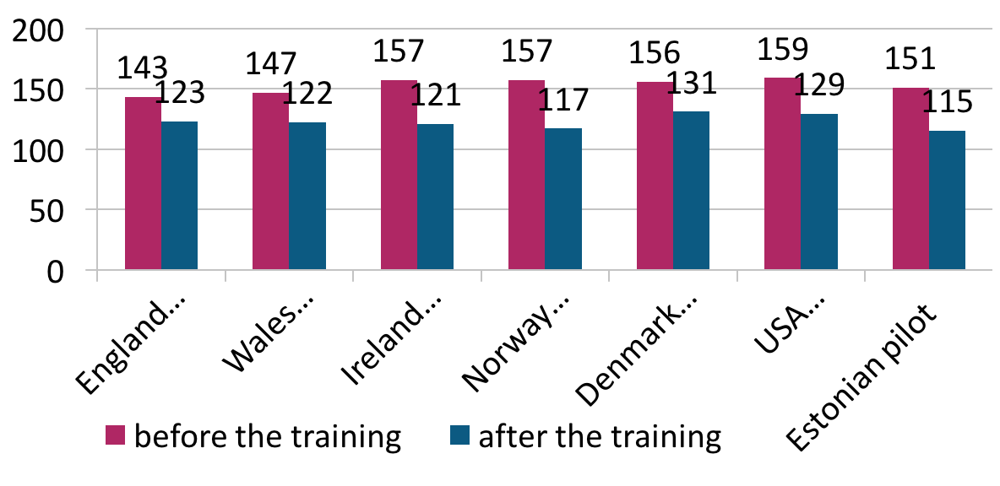
Child behavior intensity score compared to other countries
Studies concentrate on children with serious conduct problems or diagnose of disorder.
Score decreased 20 - 40 points, in Estonia 36 points (children with conduct problems).
Randomized control trials in other countries – small change also in the control group.
Incredible Years parenting program shows similar good results in different countries.

Slide 14
Incredible Years cost-benefit analysis (Civitta 2016)
Bases of the analyses: model developed in Ireland (D. O’Neill and S. McGilloway 2011) for cost-benefit analyses of IY program.
Estonian pilot data used: Costs of the IY program, results of ECBI intensity score.
Field of impact | Long term impact if conduct problems are developed (international longitudinal studies) | Data on costs available in Estonia
Academic achievements | Increased probability to drop out from high school – 7% | Costs related to not completing high school (income, taxes, health capital, etc)
Criminal activity | Increased probability to commit a crime – 10% | Costs related to crime control, dealing with the results and imprisonment (violent crimes)
Success in labor market | Longer period of unemployment during youthhood – 5 moths | Cost of support and compensation related to unemployment
Long term (related to 20s and 30s) benefit-cost ratio : 1 € spent on IY program equals to 14,3 € gained (costs saved – 12 200 €, cost of IY program per child – 852 €).
Impact not in the model: less use of health and social services, impact on parents.

Slide 15
Challenges

Slide 16
Never stop, keep improving
Uneven capacity of local municipalities to carry out their tasks: trend is that state is giving more responsibilities to the local municipalities (including funding)
Investments into prevention and evidence-based interventions are depending on political will and decisions. We still waste a lot of money on ineffective practices.
More needs to be done in building competence of specialists working with children and families
Lack of effective services (e.g. social rehabilitation of juvenile delinquents, mental health services, family support services)
    Impact assessment of the programmes and services is not yet commonly used practice – the need to support service providers and NGO-s (including decommissioning of ineffective practices)
    Good governance systems, leadership and sustainable funding!

Slide 17
Thank you for your attention!

